Slide 1
Managing Your Files

Slide 2
Objectives
Develop file management strategies
Explore files and folders
Create, name, copy, move, and delete folders
Name, copy, move, and delete files
Work with compressed files

Slide 3
Organizing Files and Folders
A file, or document, is a collection of data that has a name and is stored in a computer
You organize files by storing them in folders
Disks contain folders that hold documents, or files
Floppy disks
Zip disks
Compact Discs (CDs)
Hard Disks
Removable disks are inserted into a drive

Slide 4
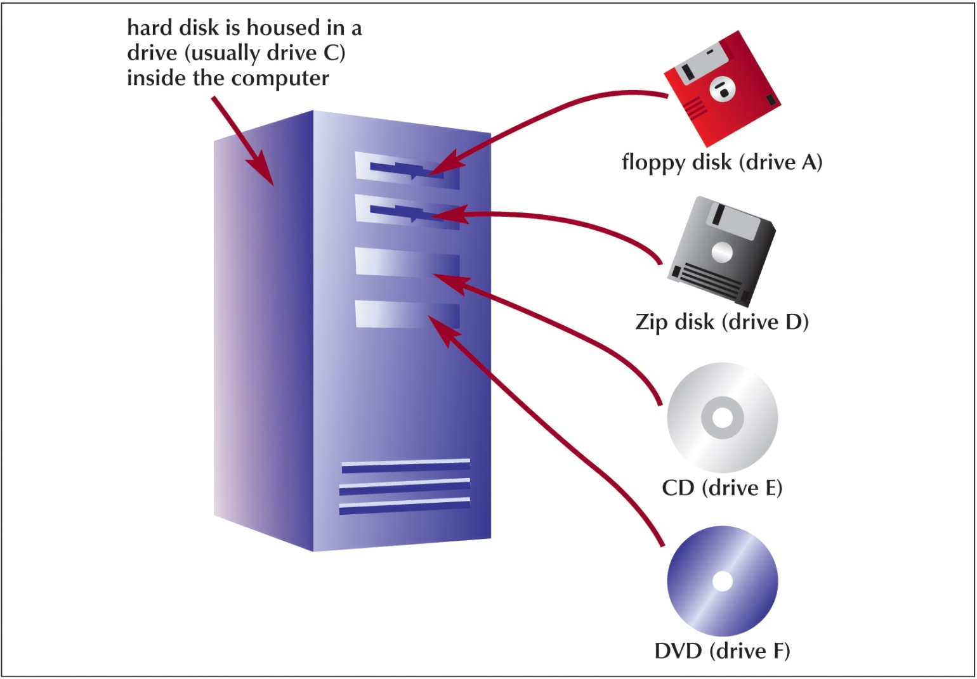
Organizing Files and Folders

Slide 5
Understanding the Need for Organizing Files and Folders
Windows organizes the folders and files in a hierarchy, or file system
Windows stores folders and important files that it needs when you turn on the computer in the root directory
Folders stored within other folders are called subfolders

Slide 6
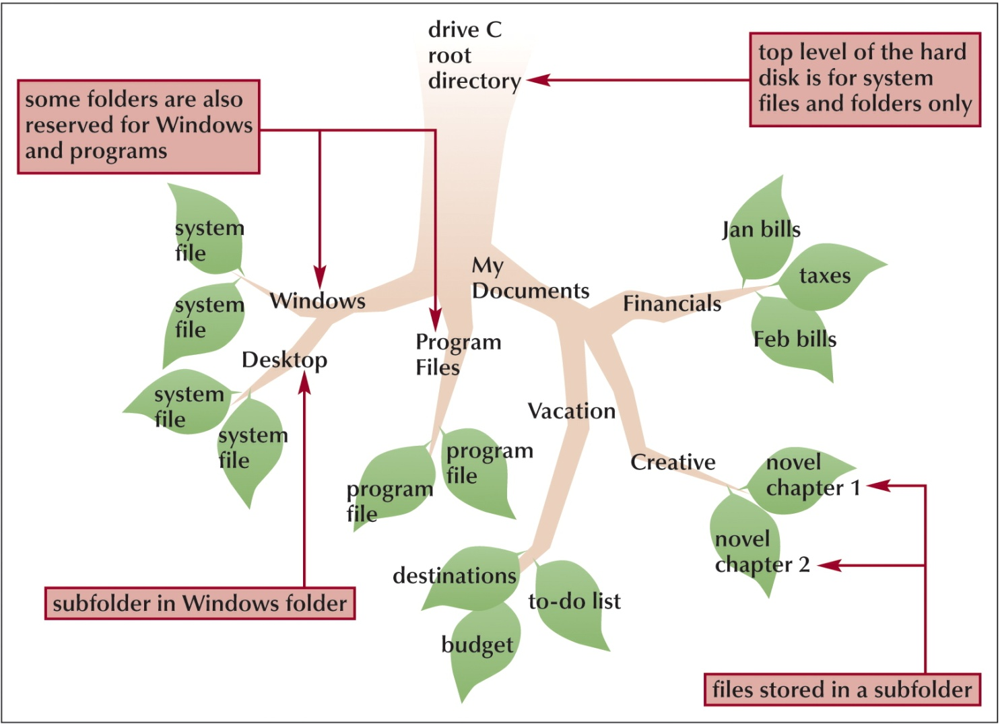
Understanding the Need for Organizing Files and Folders

Slide 7
Developing Strategies for Organizing Files and Folders
The type of disk you use to store files determines how you organize those files
Storing files on removable media allows you to use simpler organization
The larger the medium, the more levels of folders you should use
My Documents folder
You should have a backup, or duplicate copy, of important files

Slide 8
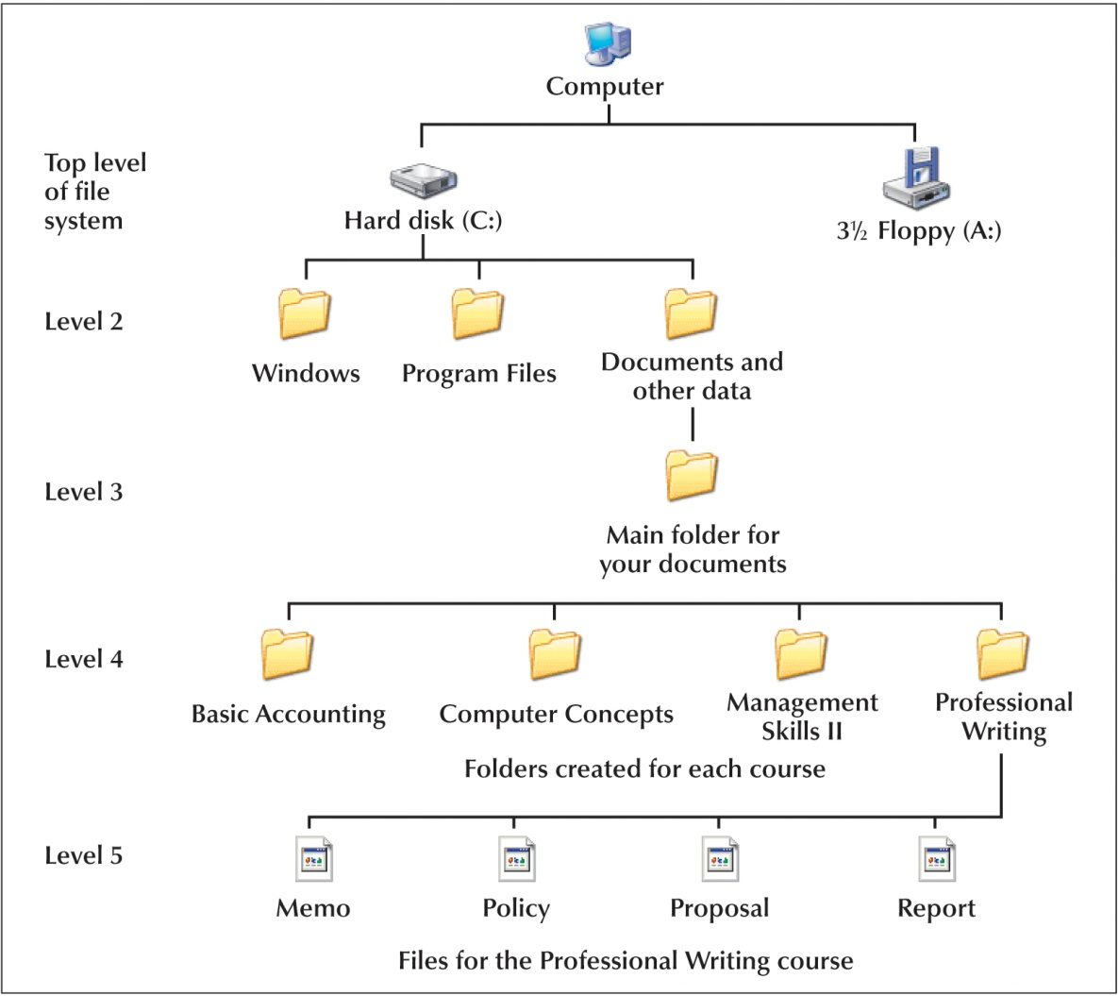
Developing Strategies for Organizing Files and Folders

Slide 9
Exploring Files and Folders
Windows Explorer shows the files, folders, and drives on your computer
Panes
Explorer bar
Folders pane
Expand icon
Collapse icon
My Computer shows the drives on your computer

Slide 10
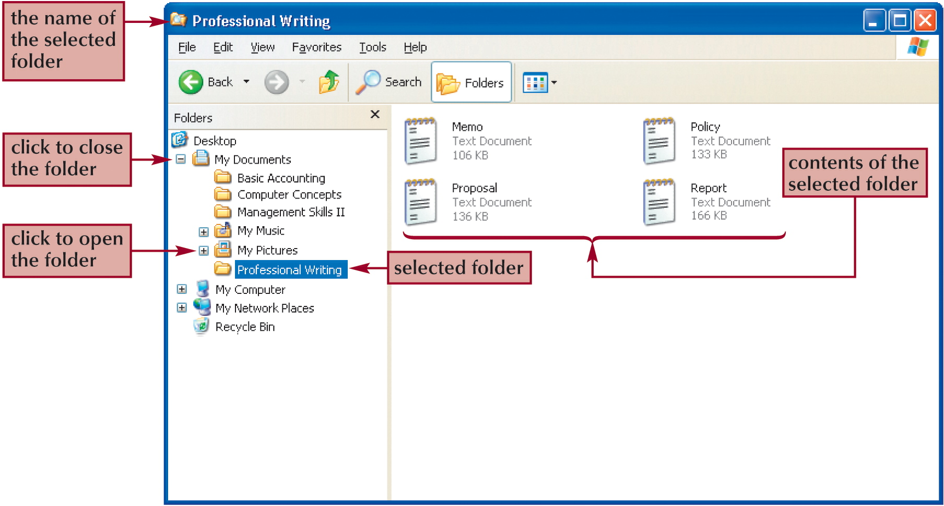
Exploring Files and Folders

Slide 11
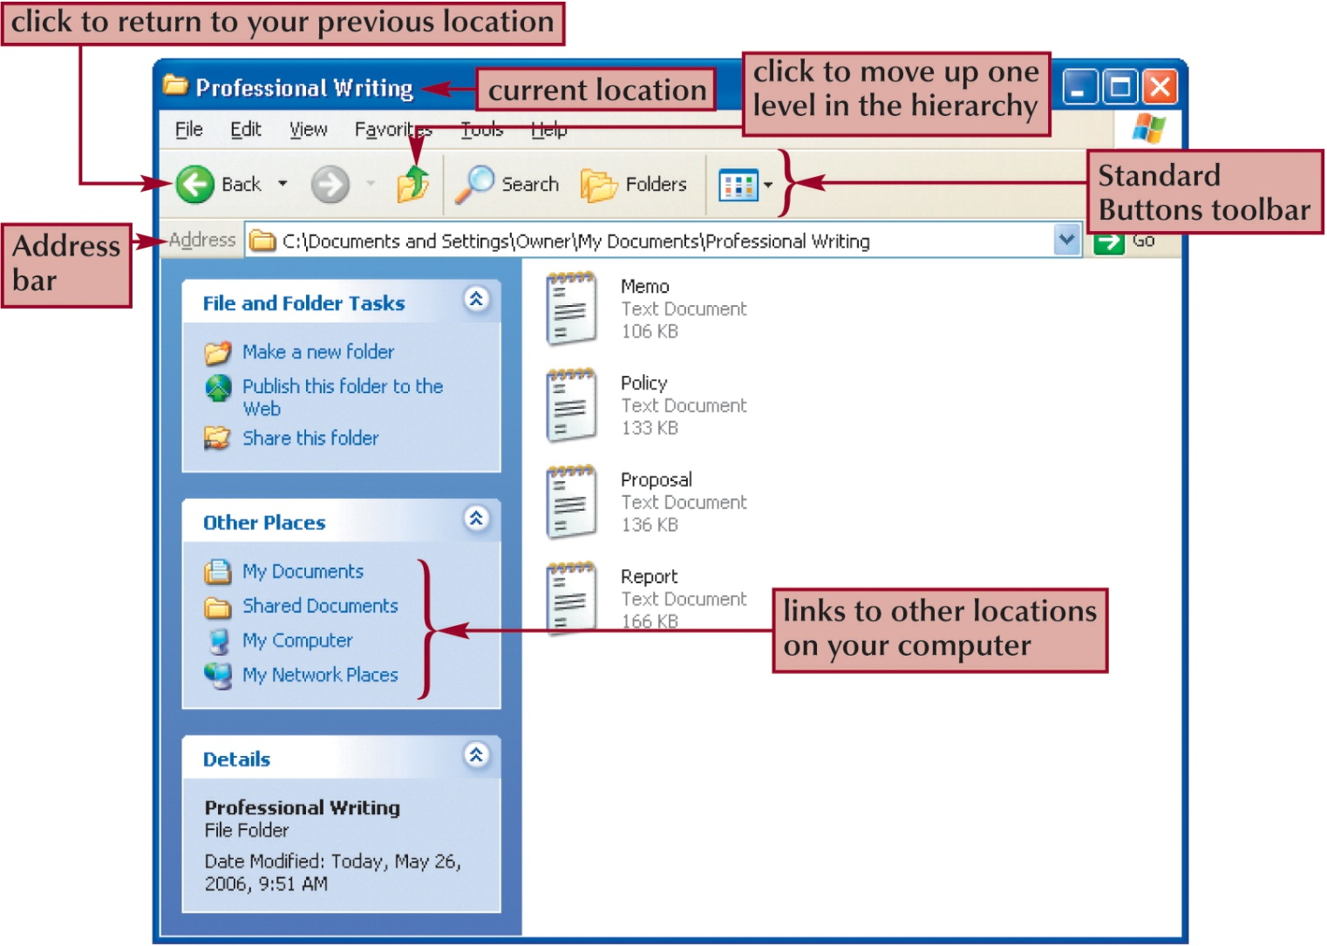
Exploring Files and Folders

Slide 12
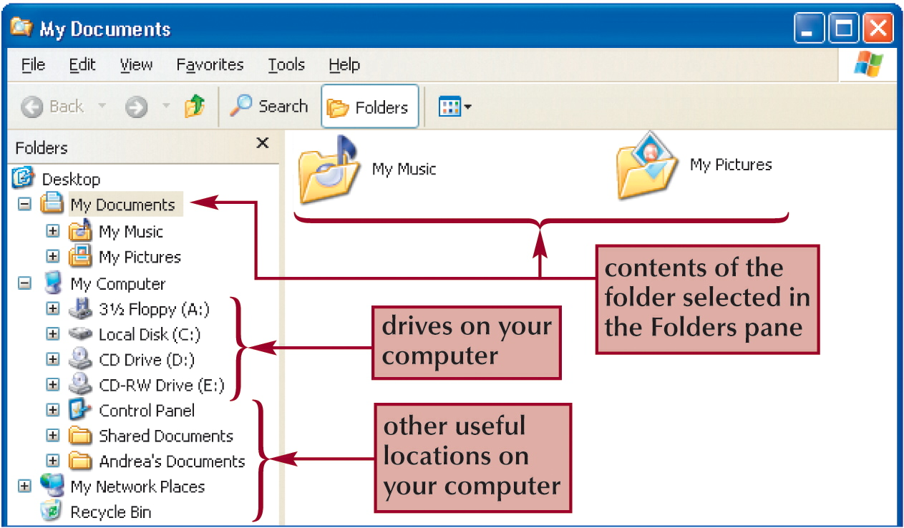
Using Windows Explorer
My Documents folder

Slide 13
Navigating to Your Data Files
The file path is a notation that indicates a file’s location on your computer
A:\FM\Tutorial\Holiday.bmp
A: is the drive name
FM is the top-level folder on drive A
Tutorial is a subfolder in the FM folder
Holiday.bmp is the full filename with the file extention

Slide 14
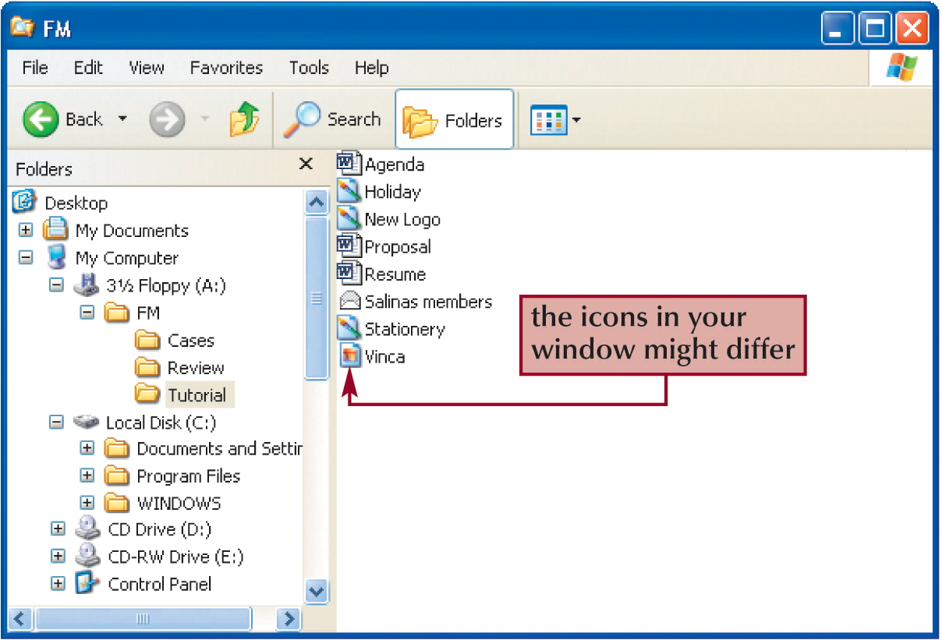
Navigating to Your Data Files

Slide 15
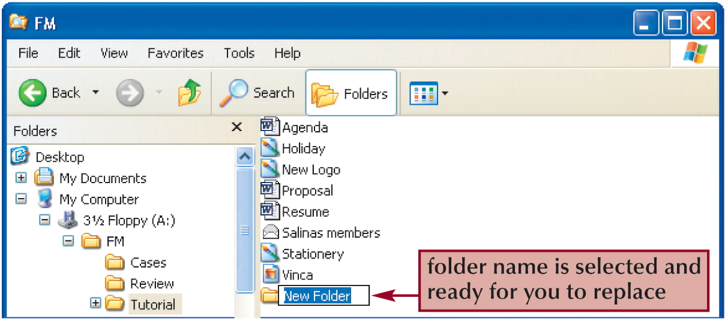
Working with Folders and Files
Creating Folders using Windows Explorer
Click File on the menu bar, point to New to display the submenu, and then click Folder

Slide 16
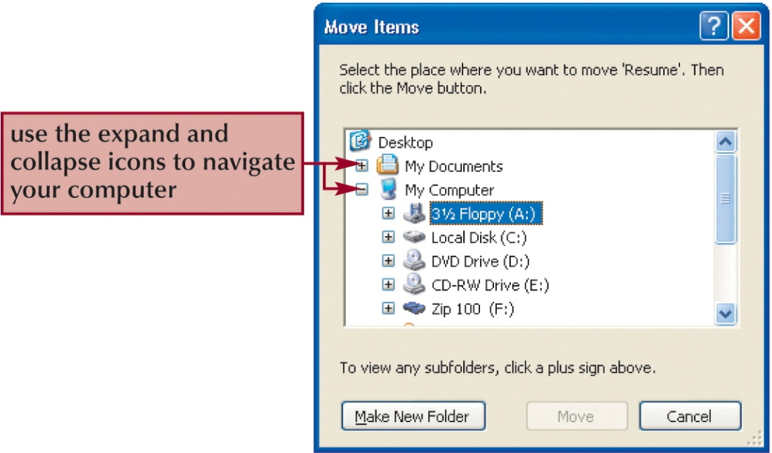
Working with Folders and Files
Moving and Copying Files and Folders
Moving a file removes it from its current location and places it in a new location you specify
Copying places the file in both locations

Slide 17
Working with Folders and Files
Naming and Renaming Files
Filenames provide important information about the file, including its contents and purpose
Main part of the filename
Dot
File extension
A filename extension identifies the file’s type and indicates the program in which the file was created

Slide 18
Working with Folders and Files
Deleting Files and Folders
The Recycle Bin is an area on your hard disk that holds deleted files until you remove them permanently

Slide 19
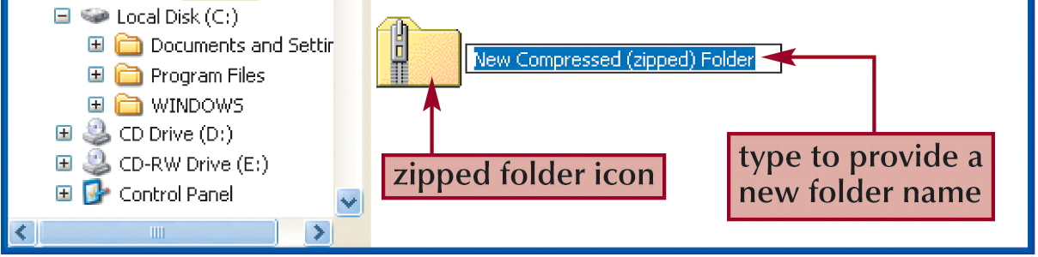
Working with Compressed Files
Files stored in a compressed (zipped) folder take up less disk space
Allows you to transfer files more quickly
Extracting a file creates an uncompressed copy of the file in a folder you specify, while the original file remains in the compressed folder
Compression programs
WinZip
PKZip

